Slide 1
A Commitment to an Inclusive UMB Community
Title IX Program The Office of Accountability and Compliance

Slide 2
Today’s objectives
2024 Title IX overview
Sex Discrimination
Expanded Scope
Privacy
Pregnant & Parenting
UMB’s Title IX Policy
Confidential Resources

Slide 3
2024 Regulations: Title IX of the Education Amendments of 1972
Went into effect on August 1, 2024
Fundamental changes to Title IX operationalization
New definitions
Formal reports standard has been removed
Expanded pregnant and pregnancy-related protections

Slide 4
‘On the Basis of sex’
Sex stereotypes
Sex characteristics
Sexual orientation
Gender identity
Pregnancy or pregnancy-related conditions

Slide 5
Jurisdiction & locations
In the education program or activities
On campus
Campus housing
Program locations
School sponsored events
Impacting the education program or activities
Anywhere if the effects meet the hostile environment definitions within the education program or activities
This can include outside the United States
Parties
Complainants can include members of the public if they have a connection to or are involved in education program or activities
Respondent must be under UMB’s control

Slide 6
Sex based discrimination
Sexual harassment
Quid pro quo
Hostile environment
Unwelcome
Sex-based
Severe OR Pervasive
AND objectively offensive
Dating Violence
Domestic Violence
Sexual Violence
Stalking
Retaliation

Slide 7
Privacy
Confidentiality of Complaints
Information Restricted Access
Disclosure Consent
Personal Information Protection
Supportive Measures

Slide 8
PREGNANT AND PARENTING STUDENTS
Pregnancy & Pregnancy-related Conditions
Equal access
Confidentiality
Prohibits discrimination
Reasonable modifications or accommodations
Lactation Accommodations
Leaves of absence
Parenting
Equal access
Prohibits discrimination
Gender role parenting stereotypes

Slide 9
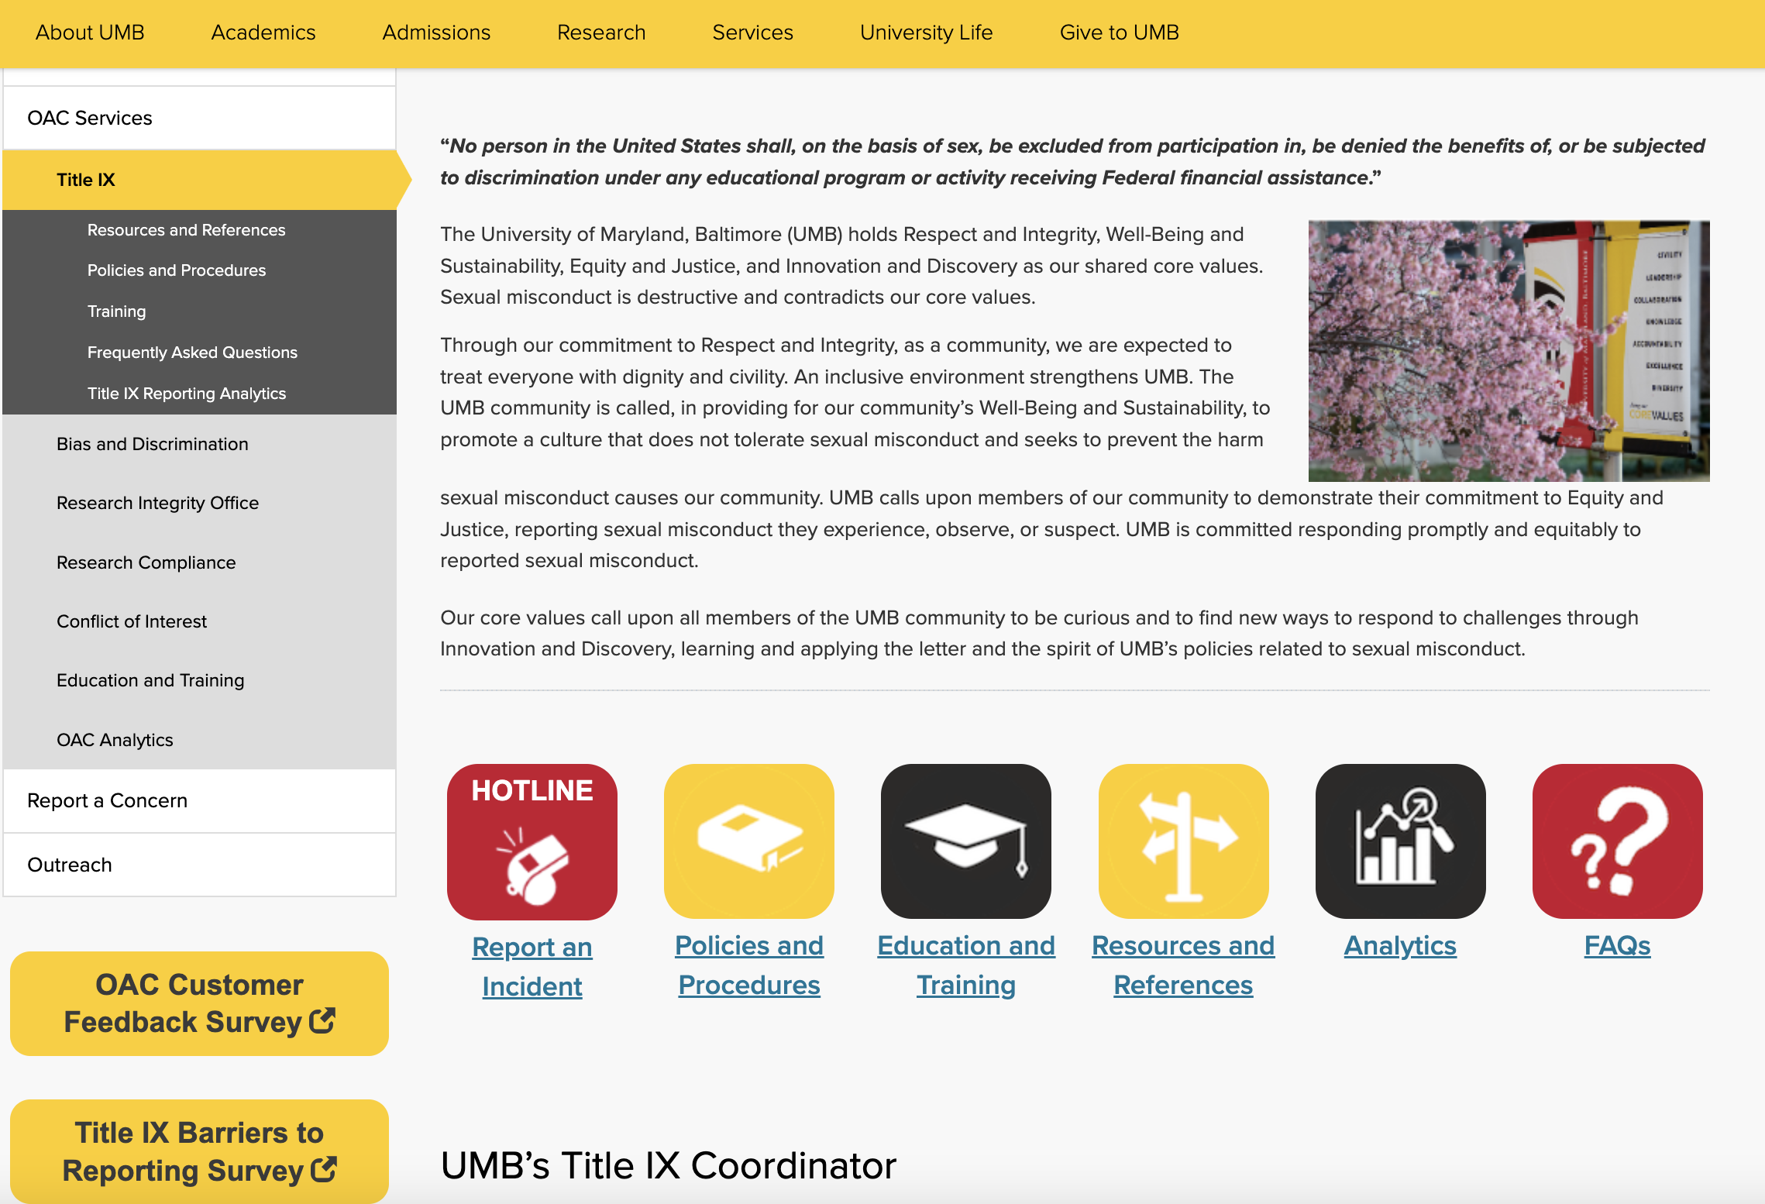
UMB’S Title IX program

Slide 10
Title IX: Reporting
UMB Hotline
umaryland.edu/umbhotline
866-594-5220
Title IX Coordinator:
Stephanie Suerth, Acting 410-706-5212 (Direct) ssuerth@umaryland.edu titleix@umaryland.edu

Slide 11
Title IX: employee Reporting
UMB Hotline
umaryland.edu/umbhotline
866-594-5220
Title IX Coordinator:
Stephanie Suerth, Acting 410-706-5212 (Direct) ssuerth@umaryland.edu titleix@umaryland.edu
Employees, with the exception of Confidential Employees, are required to notify Title IX when someone discloses incidents that may constitute sex discrimination.
Confidential employees must provide contact information for Title IX Coordinator.

Slide 12
UMB CONFIDENTIAL AND NON-CONFIDENTIAL EMPLOYEES
UMB CONFIDENTIAL EMPLOYEES
Student Counseling Center
Student and Employee Health
Employee Assistance Program (EAP)
NON-CONFIDENTIAL EMPLOYEES
Administrators
Advisors
Faculty
Staff

Slide 13
Stephanie Suerth
Acting Title IX Coordinator
Office of Accountability and Compliance
410-706-5212
titleix@umaryland.edu

